Slide 1

URL CHECKER
Panimalar Engineering College, Chennai.
Presented by
Ranjitha R-211421104205,
Priya S-211421104194.

Slide 2
ABSTRACT
The LinkChecker script is designed to check the status of links stored in a Google Sheets spreadsheet named 'LinkChecker.’
It fetches URLs from column B of the 'LinkChecker' sheet, and then performs checks on the response code and response body of each URL.
It cross-references the data with the 'Assets' sheet, aiming to detect any matching content and response codes to determine whether the link is active or removed.

Slide 3
Problem statement
The LinkChecker script addresses the need to efficiently validate the status of URLs stored in a Google Sheets spreadsheet, 'LinkChecker.’
The primary challenge is to develop a robust script that can fetch URLs from column B of the 'LinkChecker' sheet and comprehensively assess the response code and response body of each URL.
Furthermore, it must cross-reference this data with the 'Assets' sheet to identify matching content and response codes, allowing for the accurate determination of whether the link is active or has been removed.
This problem requires a solution that ensures the accuracy and efficiency of link checking while leveraging data from Google Sheets.

Slide 4
INTRODUCTION
In the vast landscape of the World Wide Web, hyperlinks are the threads that
weave together the fabric of information.
They connect websites, documents, and online resources, providing users with the gateway to a wealth of knowledge andservices.
The URL Checker is a powerful, versatile, and indispensable utility designed to check URL is Valid or Not.
The URL can be redirecting and it has the relevant page means it gives Active otherwise Removed.

Slide 5
LITERATURE SURVEY
"A Survey of Web Malware Detection" by Hassen et al. (2016) - This survey paper covers various techniques for detecting malware in URLs and websites.
"Web Accessibility and URL Validation" by Popa et al. (2017) - This research discusses the role of URL validation in ensuring web accessibility and compliance with standards.
A Web Application for URL Validation" by Zevallos et al. (2019) - This paper discusses the validation of URLs and the identification of malicious or broken links.

Slide 6
DEVELOPMENT ENVIRONMENT
Hardware
Requirements
Processor : Minimum 1 GHz
Memory (RAM) : 4 GB
Hard Drive : 32 GB
Internet Connection

Slide 7
DEVELOPMENT ENVIRONMENT
SOFTWARE
REQUIREMENTS
Google Sheets
Google Script
Java Script
Website URL’s
Functions

Slide 8
Functions
Functions involved in Link Checking process,
→Link Checker()
→escapeRegExp(str) LinkChecker Function The LinkChecker function is the primary function responsible for executing the link checking process.

Slide 9
Steps
Steps involved in link checking process,
► Retrieve Data: It retrieves the URLs from the 'LinkChecker' sheet and the assets from the 'Assets' sheet. ► Flatten Data: The assets data is flattened to a single-dimensional array for easier comparison. ► Link Checking Loop: It loops through each URL.

Slide 10
Operations
Link Checking Loop Performs The Following Operations,
► Fetches the URL to get the response code and body. ► Handles exceptions if the URL fetch fails. ► Checks if the response code is 200 (OK) and if the response body contains any match from the assets data. ► Sets the corresponding status in column C of the 'LinkChecker' sheet ('Removed' if the link is inactive or 'Active' if it is still functional).

Slide 11
escapeRegExp Function
►The escapeRegExp function is a utility function used to escape special characters in a string so that it can be used in a regular expression.
► It replaces special characters with escape characters.

Slide 12
usage
The script can be used to monitor the status of URLs in a spreadsheet, particularly to detect if any of the URLs have been removed or are still active.
It can be valuable for maintaining an up-to-date list of functional links and for monitoring changes in the status of linked resources.
It can be used as various organization to check the URLs is active or inactive.

Slide 13
considerations
Sheet Structure:
►Ensure that the 'LinkChecker' and 'Assets' sheets exist and have the appropriate columns and data structure as specified in the script.
Error Handling:
►The script includes error handling to manage situations where the URL fetch fails. It currently sets the response code to -1 and the response body to an empty string in such cases.

Slide 14
Regular Expression Matching:
►The script uses regular expressions to check for the presence of specific content within the response body. Users should ensure that the regular expression patterns are correctly constructed to match the desired content accurately.
Access Permissions:
►The script operates within the scope of the Google Sheets environment and requires the necessary permissions to access and modify the spreadsheet.

Slide 15
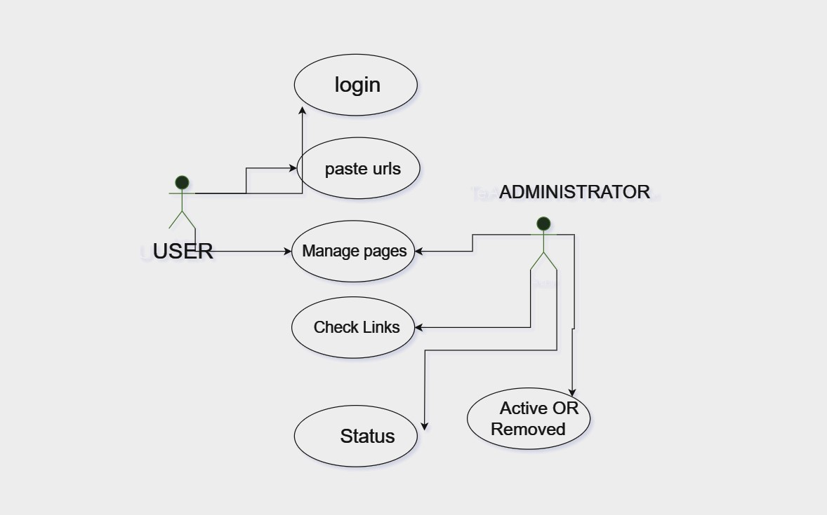
UML DIAGRAMS
USE CASE
DIAGRAM

Slide 16
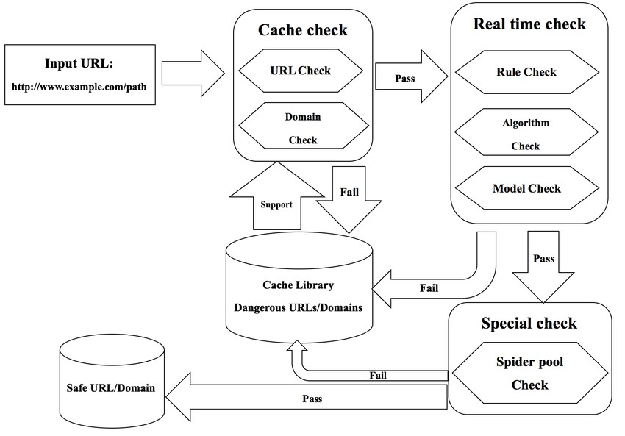
DATAflow Diagram

Slide 17
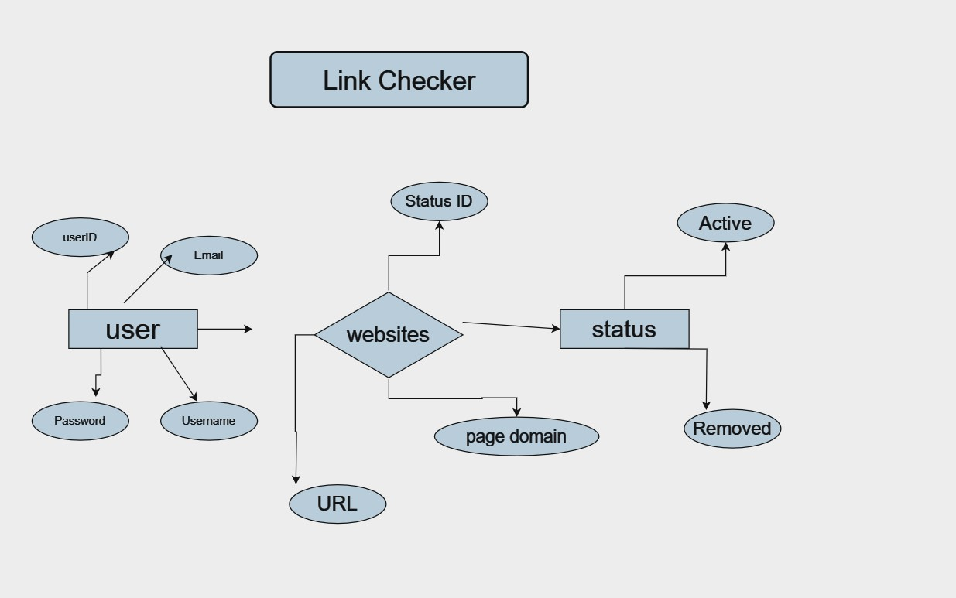
ER DIAGRAM
ENTITY RELATIONSHIP DIADRAM

Slide 18
maintenance
►Regularly review and update the 'Assets' sheet to ensure that the script accurately reflects the current state of the links.
► Additionally, monitor the execution of the script to address any potential issues related to URL fetching, data synchronization, or Google Sheets access permissions.

Slide 19
conclusion
The LinkChecker script serves as a valuable tool for automating the process of checking the status of multiple links.
By combining URL fetch functionality with content matching, it provides an effective mechanism for monitoring changes in the availability of linked resources.
Regular maintenance and careful handling of the script parameters are essential for ensuring its accurate and reliable operation.

Slide 20
FUTURE ENHANCEMENT
Enhancing a URL checker tool project to meet the needs of the future requires considering advancements in technology, security, and user experience. Here are some potential future enhancements for a URL checker tool:
Real-time Monitoring
Deeper Analytics
User-Friendly Interface
Time Management
Security Scans
Customizable Checks

Slide 21
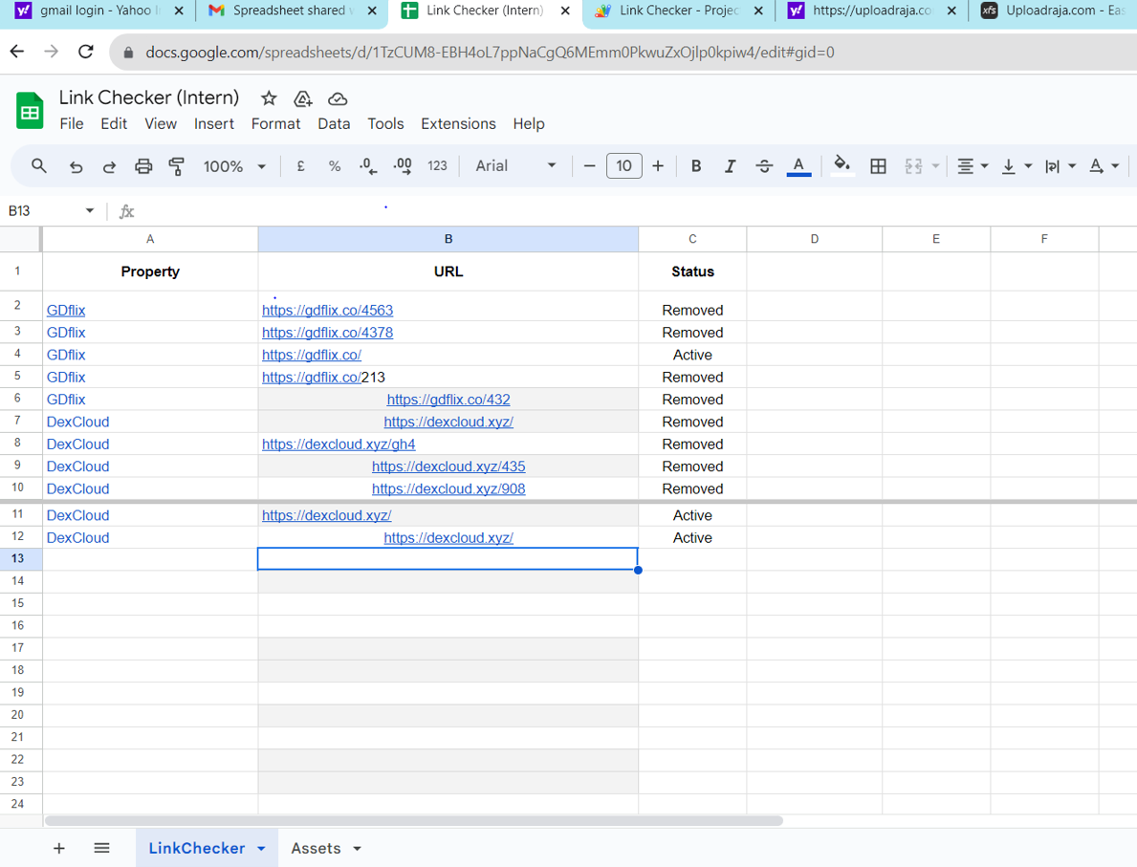
OUTPUT

Slide 22
THANK YOU

